Slide 1
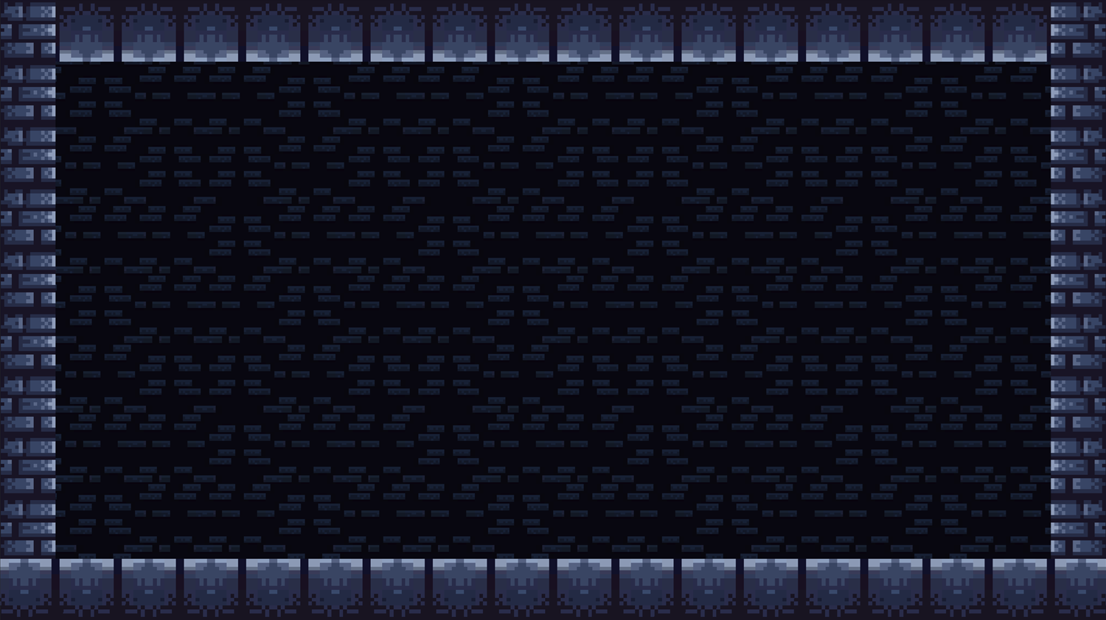

Post Mortem
Coeur d’Game
Notes:
Jacob Introduce team

Slide 2
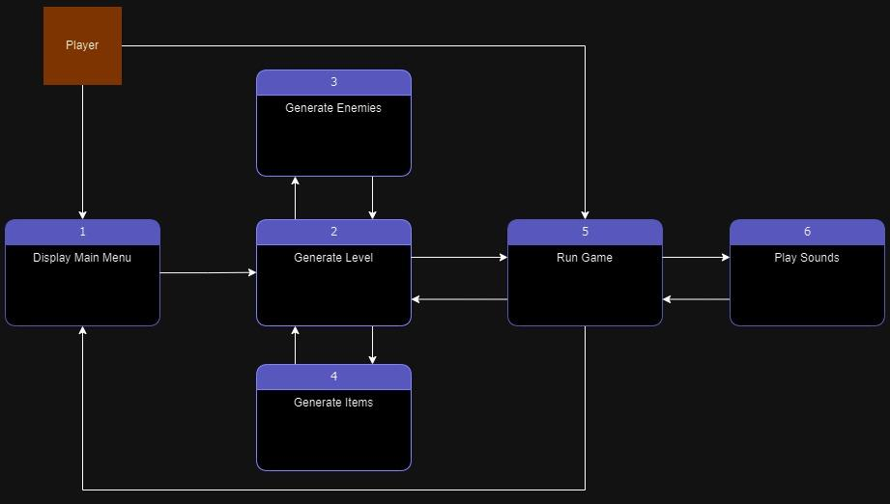
Basic Breakdown
TL1: Jacob
Level generation
TL2: Lacey
Player logic, scene management, HUD
TL3: Michael
Weapons and pickups
TL4: Caleb
Enemy logic
TL6: Joe
Sounds
Notes:
Each member introduces themself and their feature

Slide 3
GRASP and Execution Analysis
Successes:
Organization of Git
No merge errors
Separation of features, cohesion
No development broke other’s code
Regular and frequent meetings
Consistent schedule and goals
Clear and open communication
Challenges:
Imbalance of progress
Some features further developed than others
Coupling and integration
“Talking” to each other’s features
Lack of understanding across features
Notes:
S: Jacob, Lacey, Caleb C: Michael, Lacey, Joe

Slide 4
Project Changes
Harder internal deadlines for individual deliverables
Addresses imbalance of progress
Regular pair programming for feature integration
More integration across features early into development
Addresses coupling
Team handbook
Abstract documentation (how to use it, not how it works)
Addresses understanding
Ex: Sound
Notes:
Michael, Lacey & Jacob, Joe

Slide 5
Course Changes
TL1 present before TL2
Remove Platformer assignment
Distracted from other deliverables
Pair programming introduced sooner
Diverse feature integration
“Integration days” once every other week
Clearer presentation guidelines
More balanced student/instructor lectures
Instruction for deliverables (testing, AI, etc.)
Reference material
Notes:
Jacob, Lacey (2), Michael, Jacob, Caleb

Slide 6
Pair Programming
Our Project:
Player animations
Lacey: Run
Jacob: Idle
Michael: Jump
Caleb: Dead
Possible Projects:
Porting to mobile
Push enemy back during attack
Sound
Notes:
Lacey, Michael, Caleb, Joe

